Slide 1
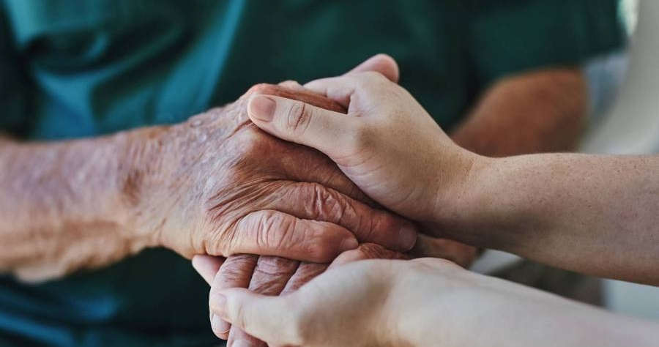
AI Assisted telemedicine kiosk
EXPLORERS​​

Slide 2
AI-assisted health care chatbot that can be set up anywhere in the village
AI Assisted telemedicine Rural residents will be able to connect with doctors via a telemedicine platform built using HTML and CSS which will be deployed using a kiosk setup in center of the village , and real-time health vitals of the patients will be stored in a MySQL database. Patients can converse with virtual assistant to share their health status, which will be saved and shared with doctors at the time of consultation in the form of graphs. To assist patients in receiving basic information and suggestions regarding their health status, a chatbot option has also been developed. kiosk

Slide 3
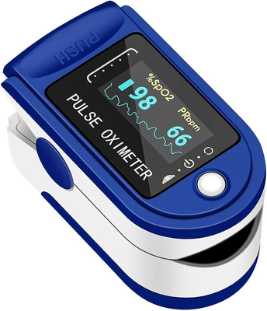
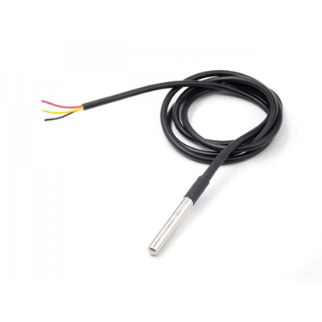

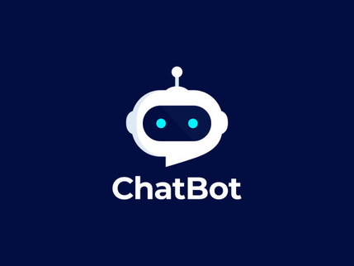


Used Technology
Hardware Used:
Software Used:

Slide 4
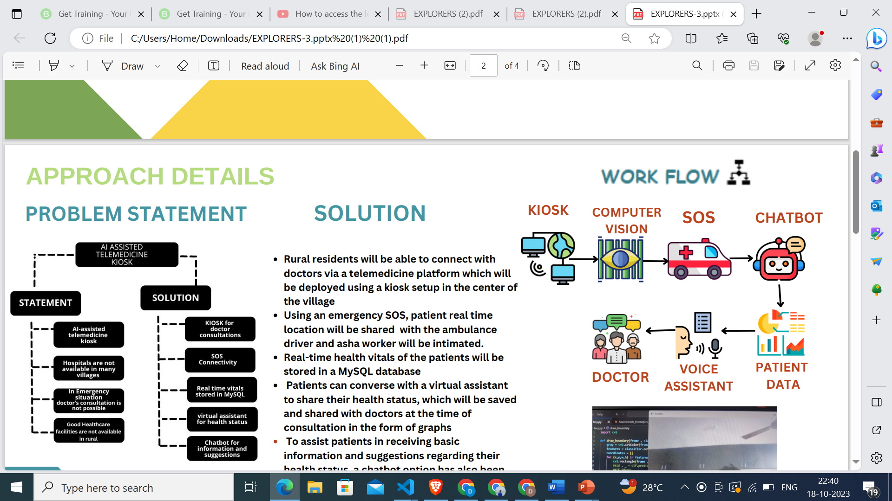
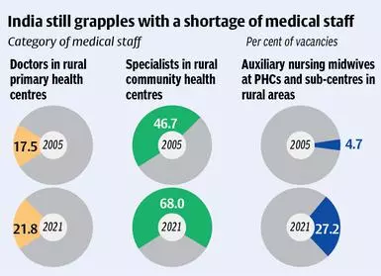
Problem
8/03/20XX
PITCH DECK
2

Slide 5
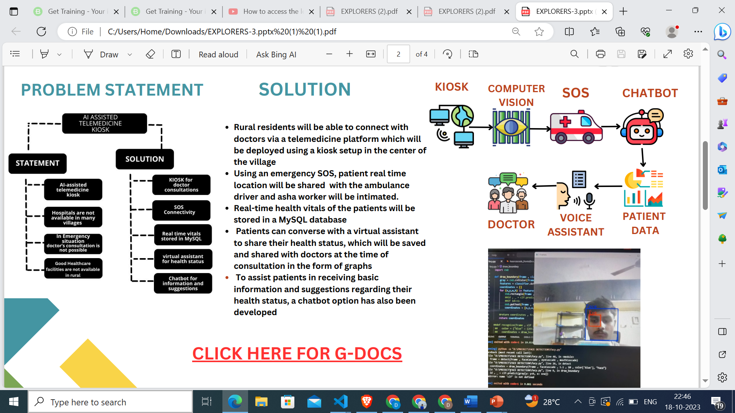
Solution
Rural residents will be able to connect with doctors via a telemedicine platform which will be deployed using a kiosk setup in the center of the village
Using an emergency SOS, patient real time location will be shared with the ambulance driver and asha worker will be intimated.
Real-time health vitals of the patients will be stored in a MySQL database Patients can converse with a virtual assistant to share their health status, which will be saved and shared with doctors at the time of consultation in the form of graphs.
To assist patients in receiving basic information and suggestions regarding their health status, a chatbot option has also been developed
8/03/20XX
PITCH DECK
3

Slide 6
Business model
In India there are around 5Lakhs plus villages where approximately around 3 lakh plus villages are small village which has around 500 people and those villages lack of basic healthcare. So those small villages nearby to each other can be combined group of 3 and in a common place the kiosk can be seted up.
TARGET CUSTOMER
Common Rural patients on time of consultation with the doctor through the portal have to pay a Rs 50 per visit.
• Individuals living in rural areas who require access to healthcare services.
Old age people have to check thier health vitals frequently and get suggestion for their health so we can have an offer like on paying Rs 500 per month they can use the platform for 30 times.
•Elderly populations in need of regular medical check-ups and monitoring.
• Patients with chronic diseases, mobility limitations, or transportation challenges who can benefit from remote consultations.
8/03/20XX
PITCH DECK
4

Slide 7
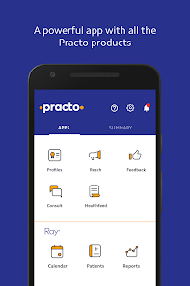
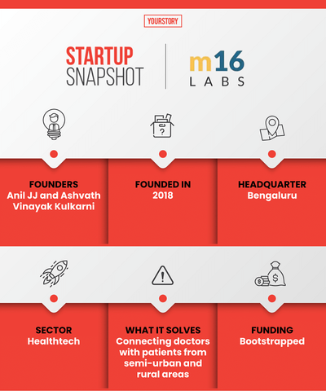


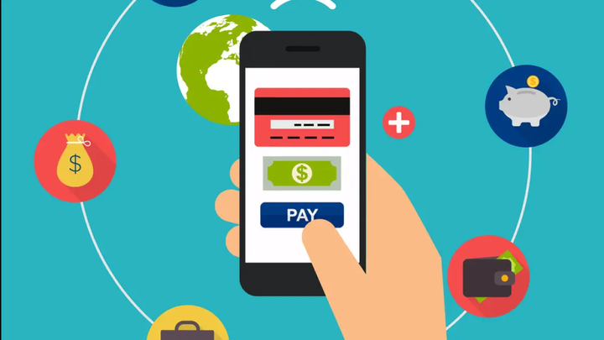
Our competitors
UNIQUE SELLING PROPOSITION
1. Voice based interface is designed so that it will be easy for rural people to use.
2. Regional local language voice assistant is deployed to make conversation easier.
3. LLM based chatbot is deployed that is used by patient when no doctor is available for consultation.
4. Real time health vitals of the patient are stored and shared with doctor on the time of consultation.
8/03/20XX
PITCH DECK
5

